Slide 1

EEG Signal Classification using transfer learning
Mohammad Mahdi Mirrashid
Dr. Shamsollahi
mohammadmahdi.mirrashid@ee.sharif.edu
EE Department – Sharif University of Technology

Slide 2
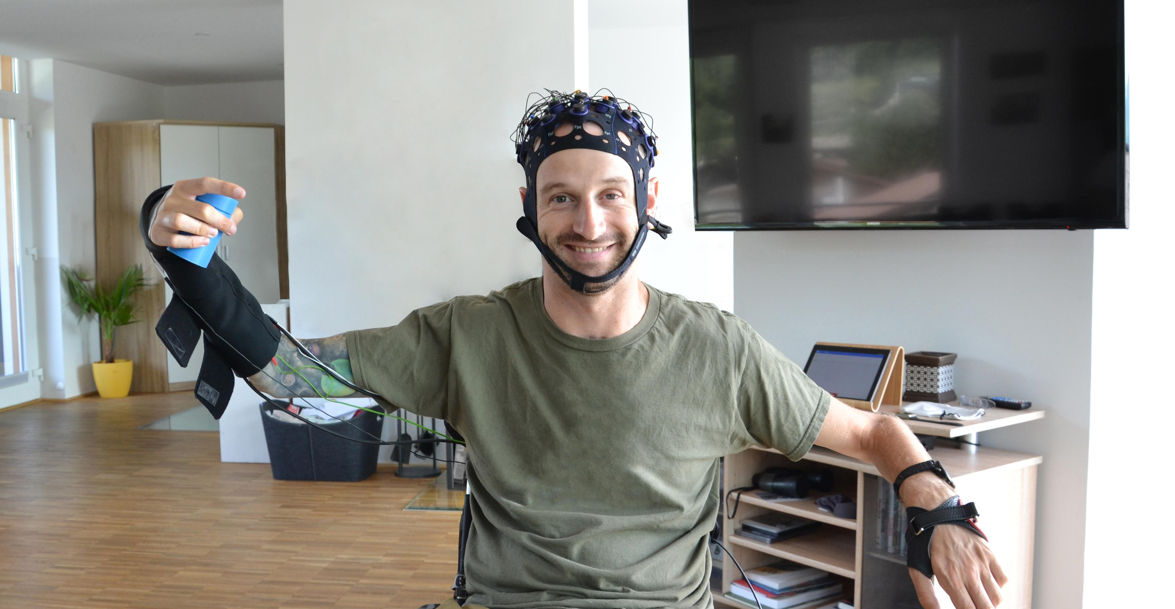
INtroduction

Slide 3
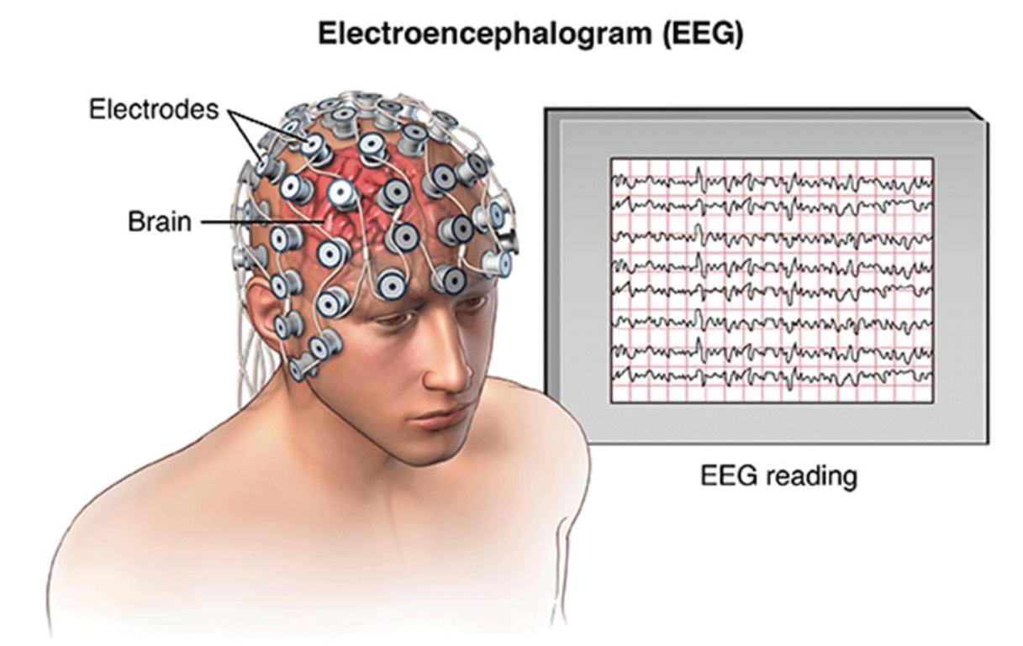
Introduction: EEG
EEG signal (Electroencephalography)
Applications
Rehabilitation
Emotion recognition
Research
Challenges
Cross subject/session variance
Noise

Slide 4
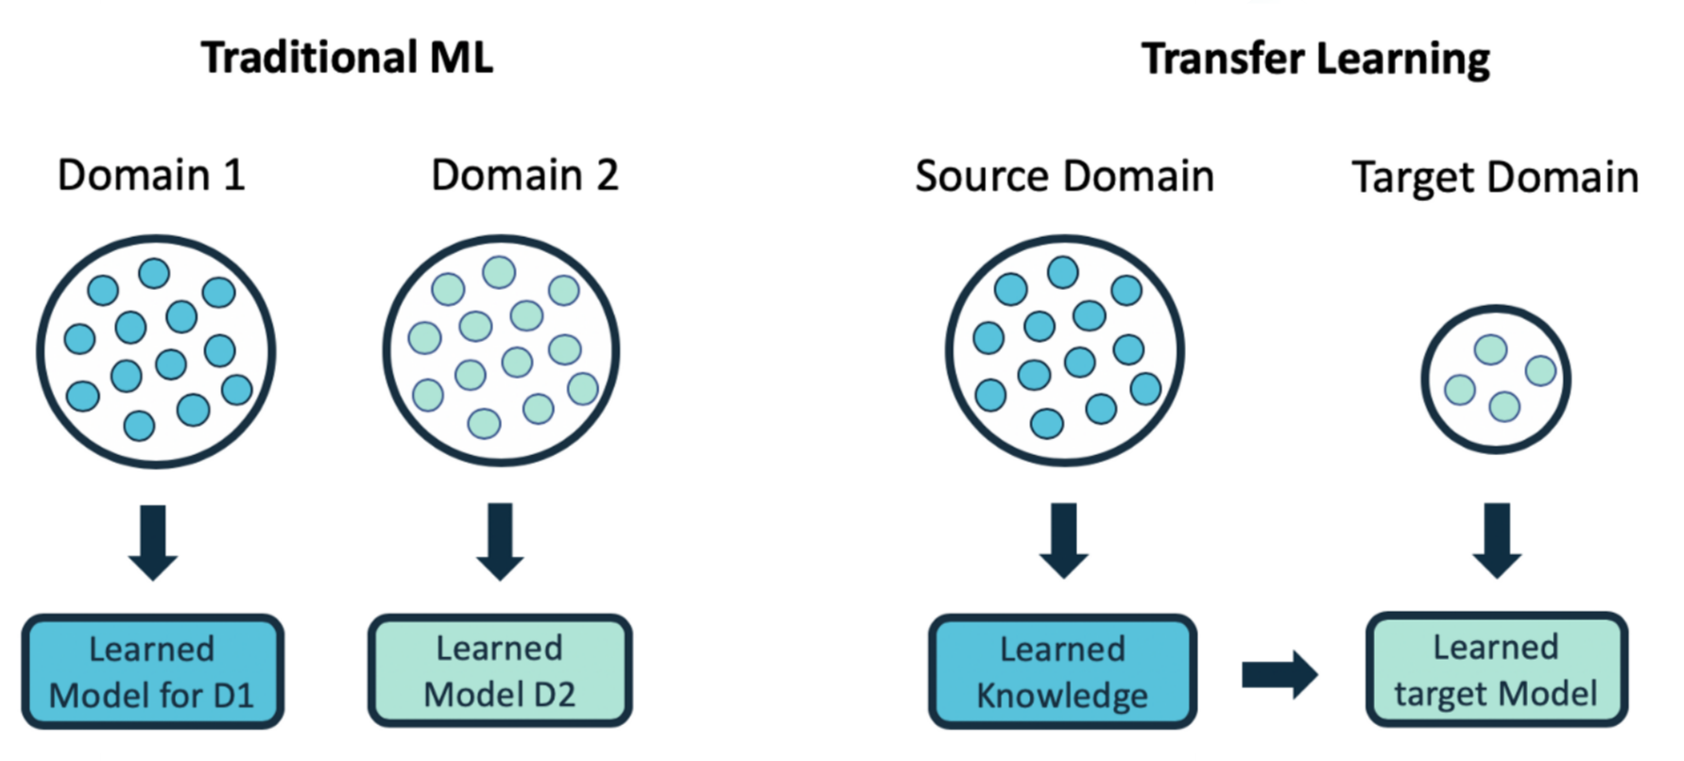
Introduction: transfer learning definition
Problem definition (domain and task)
Knowledge transfer (source to target)

Slide 5
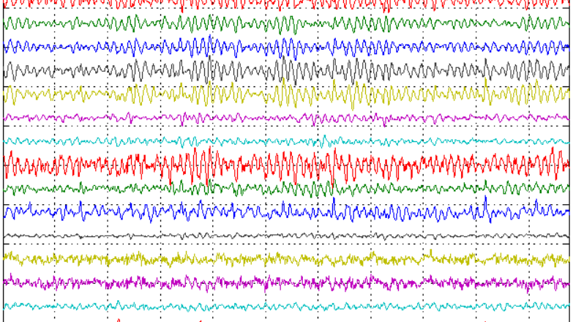
eeg signal classification using transfer learning

Slide 6
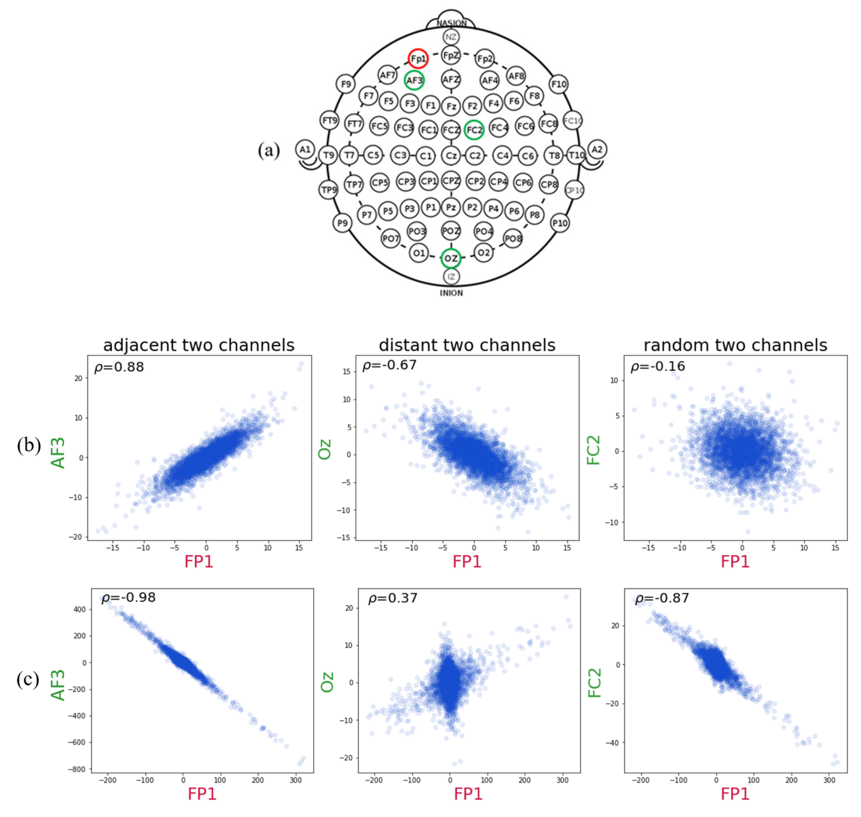
Eeg signal classification: the transfer learning approach
EEG signal variation (domain)
Lack of sufficient labeled data
Different subjects/sessions
Different devices

Slide 7
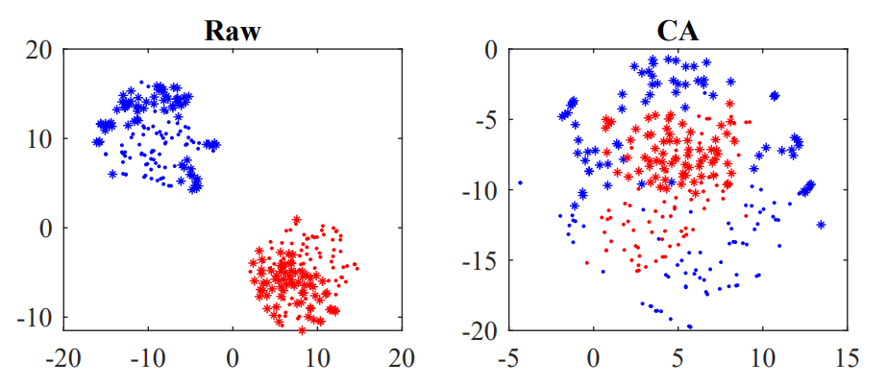
Data Alignment: introduction
Idea: make data from different subjects more similar
EEG covariance matrices are SPD and directly encode spatial information
ERP mean augmentation for temporal information encoding
RA and EA make covariance matrices more similar
RA vs. EA

Slide 8
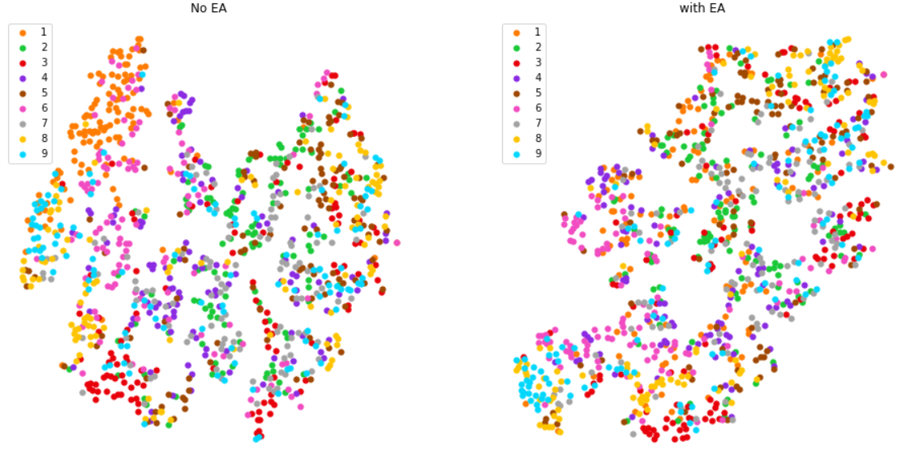
Data alignment: Results
BCIIV/2a dataset
9 subjects, 2 class motor imagery
EA+CSP feature extraction
SVM classifier
82.5% EA accuracy vs. 71.5% baseline accuracy
RA
MDRM classifier

Slide 9
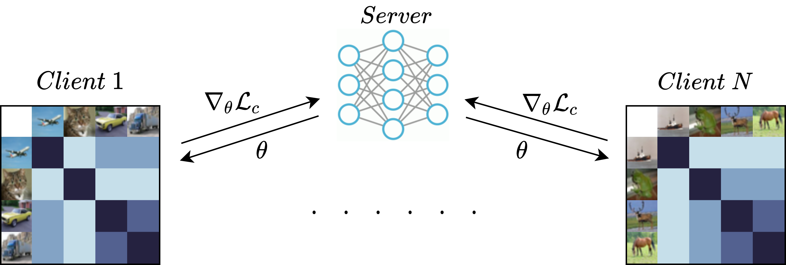
More approaches
Kernel methods
Privacy ideas
Implementation

Slide 10
Thank you!
Contact me if you’d like to know more about my project!
Any Questions?

